Slide 1


International Hepato-Pancreato Biliary Association Gallbladder Cancer Registry
LFR van Santwijk, EAJ de Savornin Lohman, PR de Reuver
on behalf of the I-HPBA gallbladder cancer registry collaborative group

Slide 2
Agenda
15 minutes
  Brief overview
  Previous meeting
  Recent progress
  Current research projects
  Future directions
Discussion & Your Input
Notes:
Brief Overview
A short reminder of the registry’s purpose and current scope.
Recent Progress
Key milestones, inclusion numbers, and expansion of participating centers.
Ongoing Research Projects
Current analyses, collaborations, and preliminary findings.
Future Directions
Planned studies, strategic goals, and opportunities for growth.
Discussion & Your Input
Feedback, ideas for new projects, and possibilities for collaboration.

Slide 3
Brief Overview

Slide 4
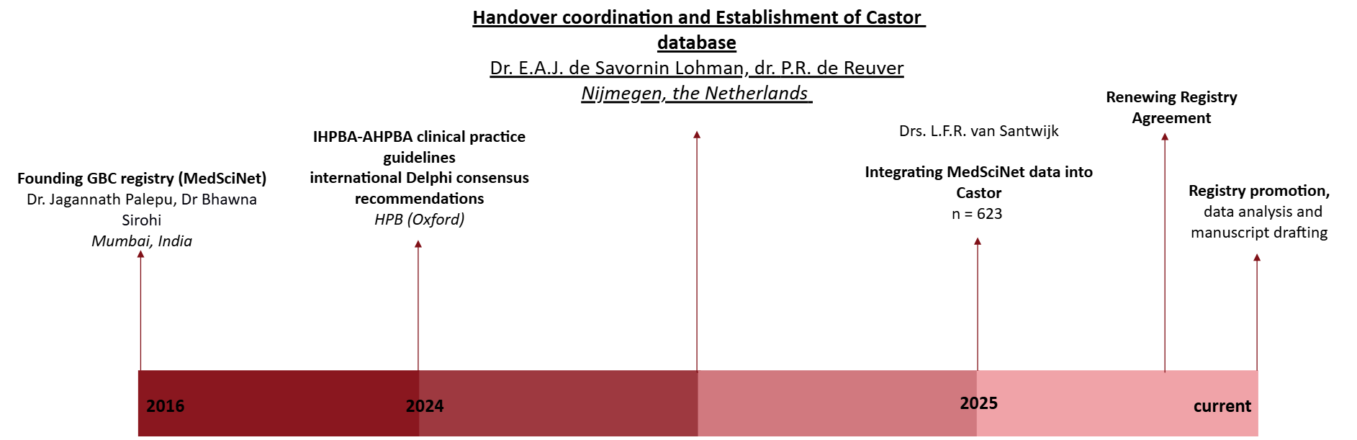
Background
Notes:
For those not familiar with the IHPBA GBC Registry …..
2016, the International GBC Registry (MedSciNet) was founded under the guidance of dr. Jagannath and dr. Sirohi in India. There were over 1400 cases registered in the MedSciNet database.
In July 2024, the recommendations on the management of GBC were formulated in the Delphi consensus meeting.
The coordination of the registry was handed over to Elise and Philip. Coordination of the registry was transferred to Elise and Philip. A redesigned database was subsequently developed in Castor, guided by the updated Delphi consensus recommendations.
Since then, Lusien joined our registry team as PhD candidate and continued on expanding the registry by integrating the MedSciNet patients into the reformed database. Furthermore, new collaborations were formed abroad. A study group was formed in Copenhagen, Denmark. And currently two bright medical students are visiting Australia, to establish new collaborations. The first Austalian data has been added to the registry last week!

Slide 5



Our mission
Notes:
By using multicenter international data we aim to:
Bridge knowledge gaps (e.g. treatment of GBC)
Aid in the development of uniform and clear guidelines
And ultimately improve patient care

Slide 6



Data collection: inclusion
Notes:
All patients 18 years and older, diagnosed with GBC from 2016 onwards can be included in the registry. In the registry, data will be collected both retrospective- and prospective.
We collect data regarding all GBC patients, those with and without surgerry

Slide 7







Data collection: variables
Notes:
Data is collected into Castor, which is more innovative than the old MedSciNet data registry. Tekortkomingen bespreken.
Different data is collected in Castor (our online database).
Demographics
(age, gender, country of origin etc.)
Clinical characteristics
(modality of diagnosis, lab. values, stage at presentation etc.)
Treatment characteristics
((neo)adjuvant therapy, surgical treatment, histopathology etc.)
Follow-up outcomes
(recurrence, survival)

Slide 8
Short recap

Slide 9
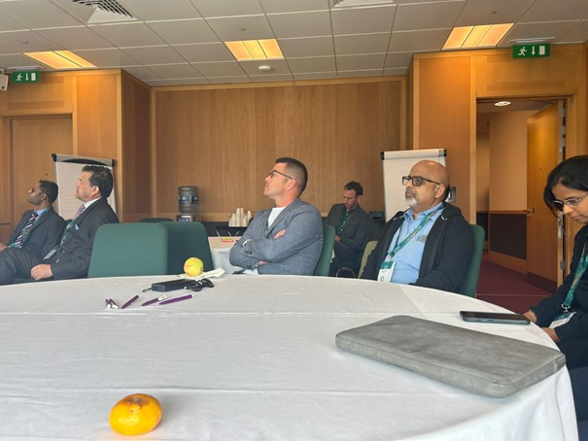
IHPBA GBC Registry Meeting – June Dublin
(Bi)annual meetings
  Online
Better visibility
Personalised reminders
Notes:
First of all, we’d like to mention that your input is very much valued and we take all suggestions into consideration. So let’s have a look at discussion points of our last IHPBA GBC Registry meeting and how we have handled them.
It was noted that regular meetings to provide progress updates and discuss future directions of the registry were desirable. Therefore, we are organising this meeting and plan to hold at least one registry meeting annually. We will do our best to align these meetings with major conferences to facilitate in-person discussions and networking. However, if biannual meetings are scheduled, they may not always coincide with a conference.
Today marks our first online Registry Meeting. After the session, we would appreciate your feedback on whether you find this format useful and how you would like future meetings to be organised.
During the last registry meeting, participants mentioned that the IHPBA GBC Registry website was difficult to find. Since then, we have updated the website to improve visibility. We also aim to distribute monthly newsletters through the IHPBA to reach more people and increase awareness of the registry.
It was further mentioned that the process of joining the IHPBA GBC Registry was unclear. In response, we have added a new webpage providing step-by-step instructions on how to join the registry.
When cleaning data for specific research questions, personalised reminders to review or update data will be sent. In addition, we will remind all centres to update their data at every biannual meeting.

Slide 10
Recent progress

Slide 11
Registered cases
Notes:
We now have 1,739 registered cases, showing a clear and encouraging rise in inclusions over the past year.

Slide 12
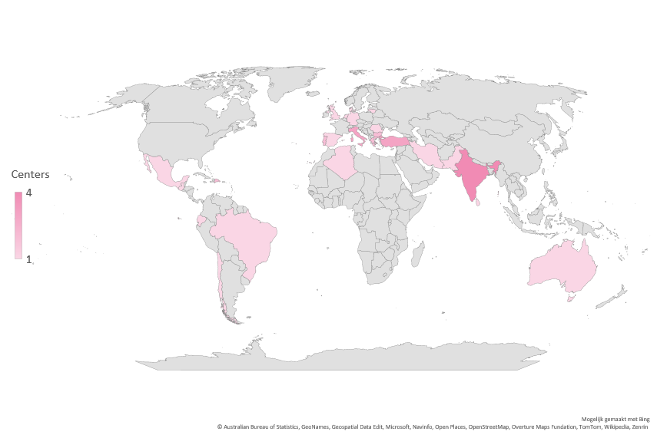
Participating centers per country - June 2025
Notes:
At our last registry meeting at the I-AHPBA conference in Dublin, 24 countries had entered data into the IHPBA GBC registry.

Slide 13
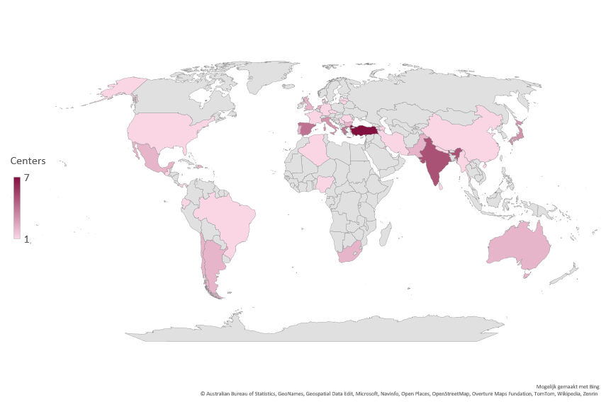
Participating centers per country - November 2025
Notes:
Since then 10 additional countries have entered data, totalling 34 pariticipating countries

Slide 14
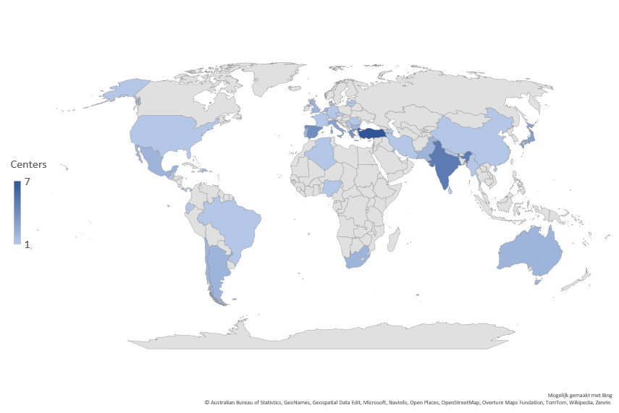
Participating centers per country
Notes:
Since then 10 additional countries have entered data, totalling 34 pariticipating countries

Slide 15
Renewed Registry Agreement
Aligned with updated international privacy regulations
Replaces the old DSA
Facilitates data sharing with participants
Clear collaboration guidelines
(data collection, authorship and study proposals)
Notes:
New Registry Agreement
Replaces the previous DSA.
Facilitates data sharing both during entry into Castor and when exporting data to participants for approved research proposals.
Reinforces the registry as a collaborative initiative, ensuring all participants feel involved and can access data for their own research questions.
Furthermore, we will publish a document with clear collaboration guidelines on our website.

Slide 16
Main aspects of authorship
Following ICMJE criteria
2 collaborators (>50 cases: 3rd)
Authorship based on contribution (project proposal, data analysis, writing)
Coordination team: authorship for structural contributions
Collaborators are acknowledged only when their data are used
Steering Committee: reviews for project proposals and reviews manuscript on authorship and data protection
Notes:
New Registry Agreement
Replaces the previous DSA.
Facilitates data sharing both during entry into Castor and when exporting data to participants for approved research proposals.
Reinforces the registry as a collaborative initiative, ensuring all participants feel involved and can access data for their own research questions.
Furthermore, we will publish a document with clear collaboration guidelines on our website.

Slide 17
Steering committee
• Composition → registry history & continental representation
• Changes → based on contributions to registry output
Jagannath Palepu, Lilavati Hospital, Mumbai, India
Philip de Reuver, Radboudumc, Nijmegen, The Netherlands
Bhawna Sirohi, Vedanta Medical Research foundation- Balco Medical Centre, India
Elise de Savornin Lohman, Radboudumc, Nijmegen, The Netherlands
Lusien van Santwijk, Radboudumc, Nijmegen, The Netherlands
Shailesh V. Shrikhande, TMH Hospital, Mumbai, India
Vikram Choudhary, TMH, India
Itaru Endo, Yokohama City University, Yokohoma, Japan
Xabier de Arextbala, Chile
Martin Smith, South Africa
Bill Jarnagin, MSKCC, USA
Javier Lendoire, University of Buenos Aires, Argentina
Elijah Dixon, University of Calgary, Canada
Joris Erdmann, Amsterdam UMC, the Netherlands
Hauke Lang, Germany
Mikel Prieto Calvo, Cruces University Hospital, Spain
Shishir Maithel, ECOG, USA
Oscar Imventarza, Hospital Dr Juan P Garrahan, Argentina

Slide 18
Current research projects

Slide 19
Extent of liver resection and survival outcomes in T3 GBC
Background: no consensus WR versus SR for T3 GBC
Aim: evaluate the impact of liver resection on 1Y- and 3Y OS and RFS
Population: T3N0-2M0 GBC
Outcomes: 1Y- and 3Y-OS, 1Y- and 3Y-RFS and complications
Progress: analyses completed and manuscript drafted

Slide 20
Development of a prediction model for R0 resection
Background: up to 30% ≠ R0. No validated pre-op model exists yet.
Aim: Develop & validate a pre-op model to predict R0 resection
& assess OS by predicted outcome.
Population: Patients ≥18 undergoing curative-intent surgery (2015–2025)
Outcome: Preoperative prediction tool predicting R0 resection to guide MDT and shared decision making
Progress: tool in development, introduction and methods drafted

Slide 21
Optimal extent of LN resection in early GBC
Background: unclear survival benefit of D2 LNR in early GBC and additional procedures with associated risks
Aim: to determine survival impact of no LNR versus D1 and D2 LNR
Population: T1b and T2 GBC
Outcomes: OS, RFS and complications
Progress: abstract and introduction done, analysis being done
Notes:
For T1b and T2 gallbladder tumors, radical cholecystectomy with lymph node resection is recommended. Consensus guidelines suggest a standard D2 lymphadenectomy, but evidence on survival benefit is mixed, with some studies showing benefit mainly for T2 and others for both T1b and T2 tumors. Adequate staging requires at least six nodes, yet many patients are understaged. D2 resection may also require additional procedures, like CBD or pancreatic head resection, which increase morbidity and mortality. Given these risks and conflicting evidence, our study compares survival outcomes after no lymphadenectomy, D1, or D2 resection in T1b–T2 GBC.

Slide 22
Future directions

Slide 23
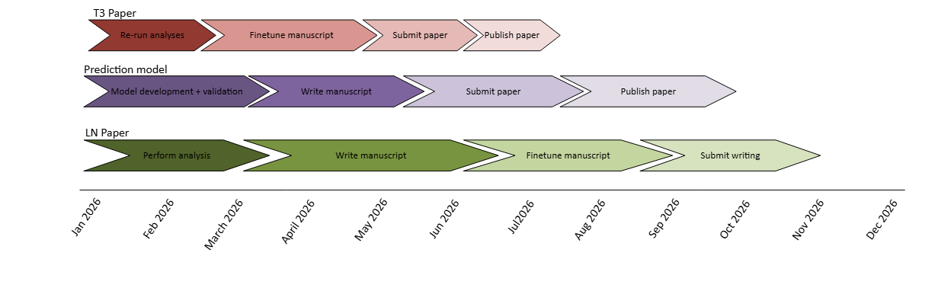
Future plans
Next IHPBA-GBC Registry meeting: Singapore Oct ‘26

Slide 24
Discussion

Slide 25
Discussion: logistical
Priorities of the registry
How to incentivize regional participation, especially in low/ middle income countries?
Streamlined data collection
Authorship
Opportunities for clinical trials
Grant opportunities?
Notes:
Order behouden door mensen handje op te laten steken.
We already have some low- and middle-income countries participating in the registry, but low-income countries remain underrepresented.
By revising the Registry Agreement, we aim to simplify data sharing, allowing participants to use registry data for their own research proposals. This will serve as the main incentive for participation.
We are very interested in your ideas on how to better engage low- and middle-income countries and what types of incentives could encourage their participation.
Although we currently don’t collect data regarding robotic surgery in the registry, we do collect data regarding laparoscopic and open surgery. Although we do have the option to fill in “Other” for type of surgery. And we have data regarding complication, recurrence and survival.

Slide 26
Discussion: Research
Nodal spread:
  is resection valuabe in N2 disease?
  What should be the extent of nodal dissection?
  6 LNs from station 12 and 8 or complete LN dissection from the ligament.
The value of robotic/ minimally invasive surgery
The role of ICG in the management of GBC
Treatment of oligometastatic disease
Radical cholecystectomy without resection for peritoneal side early iGBC
The role of a sentinel node procedure
Role of NACT and NART
Screening program for high risk populations
Notes:
As discussed previously we are currently analysing the added value of D1 and D2 LN resection in the management of early GBC.

Slide 27

Questions?

Slide 28


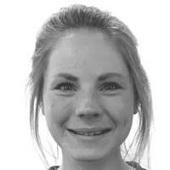

Thank you for your attention
Philip de Reuver: Surgeon, Principal investigator
Elise de Savornin Lohman: PostDoc, study coordinator
Lusien van Santwijk: PhD candidate, study coordinator
E-mail: gbcregistry.heel@radboudumc.nl
Website: https://gbcregistry.com/
Visit our website!

